Slide 1
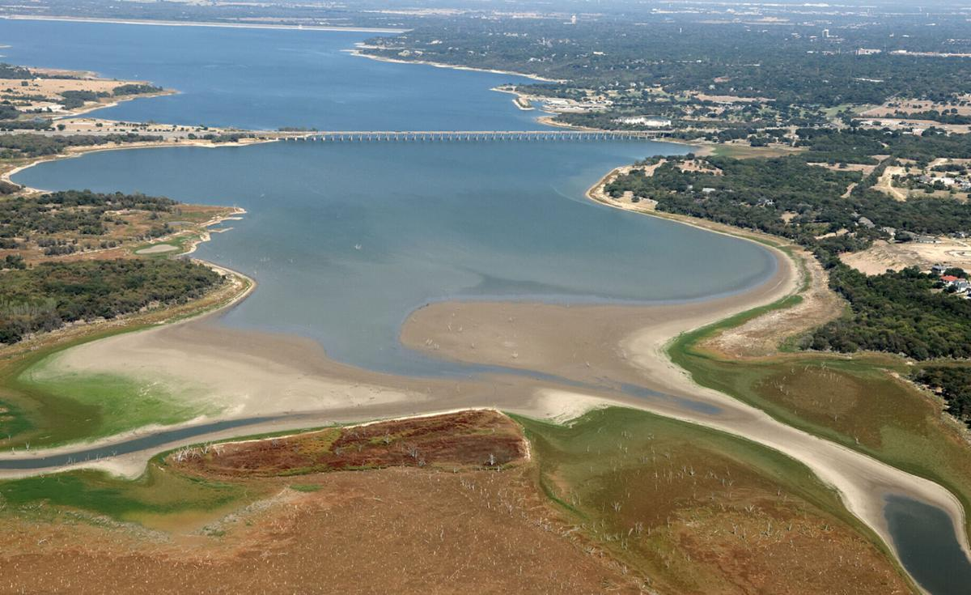
Using ChatGPT for Working with GPX Data
Luke Day – BIO 5100

Slide 2
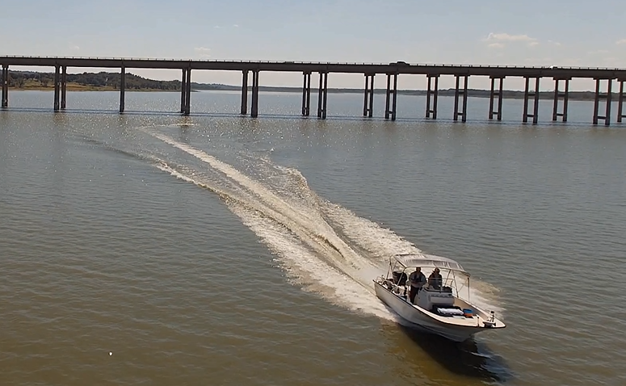
Background
Sensor boat
Lake Waco
GPX Files
Bathymetry

Slide 3
Objectives
Develop a pipeline for reading .GPX files in R
Generate bathymetric map of Lake Waco
Do as little manual coding as possible

Slide 4

Approach
Approach ChatGPT like a conversation
Ask for conceptual explanations when needed
Provide specific details on files and functional code
Use one continuous conversation thread

Slide 5
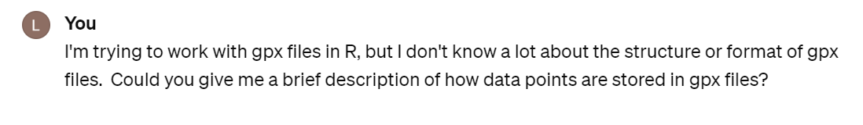
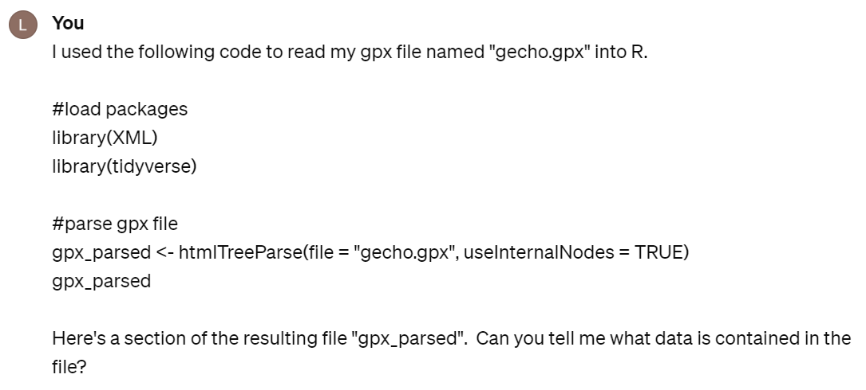
Providing a Framework

Slide 6
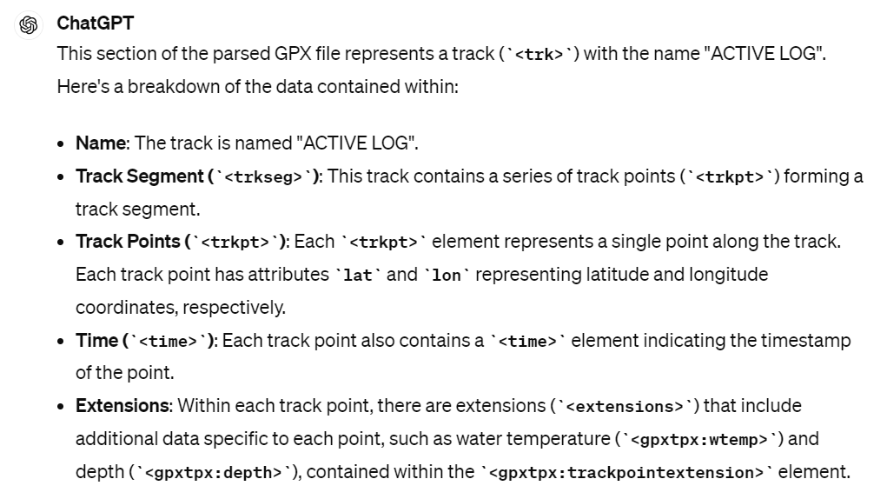
Providing a Framework

Slide 7
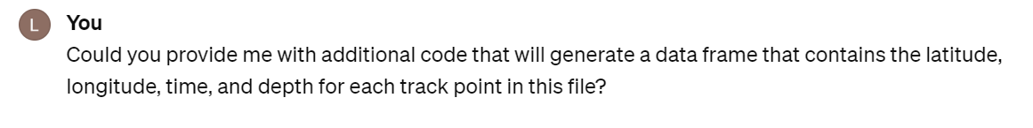
Generate a Data Frame

Slide 8
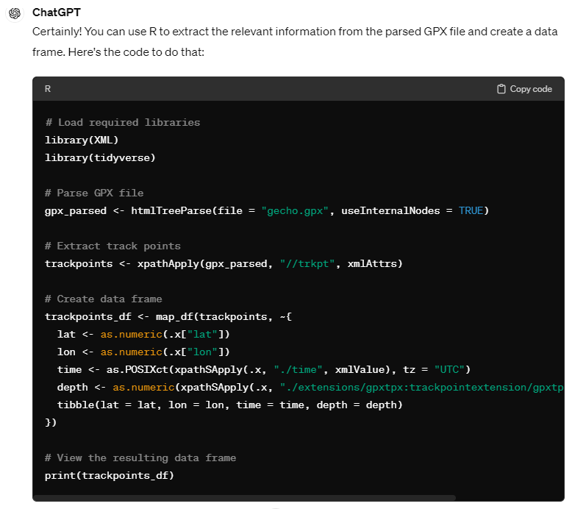
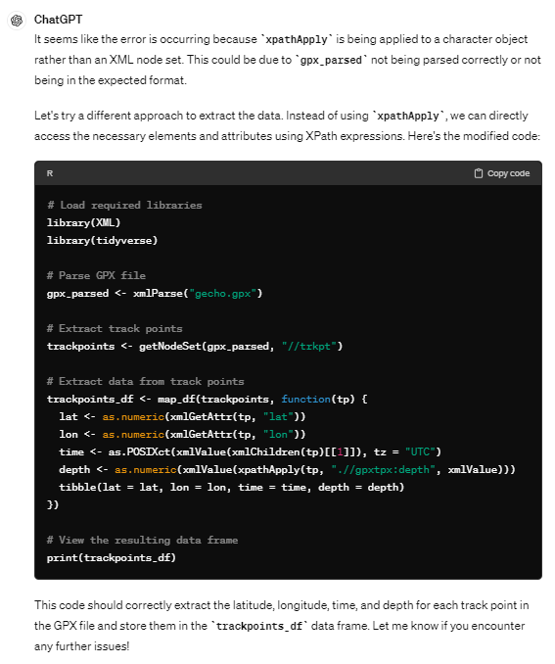
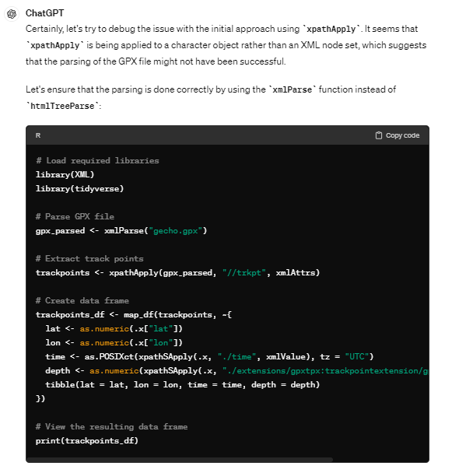
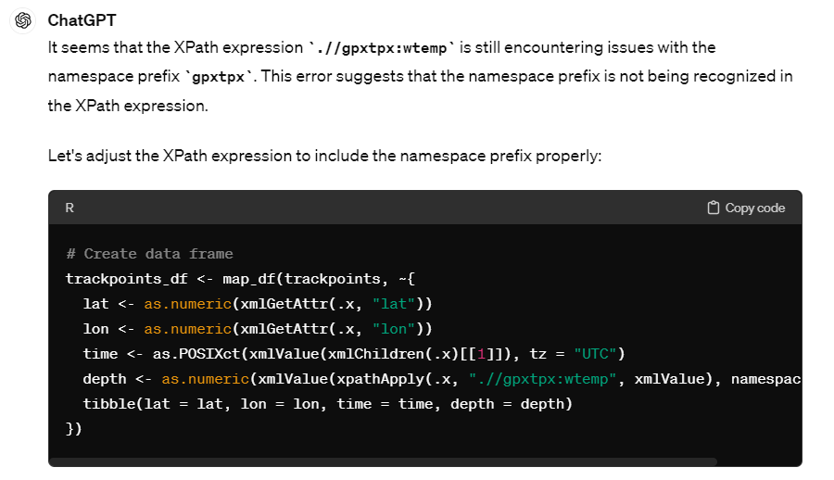
Generate a Data Frame
MULTIPLE ERRORS

Slide 9
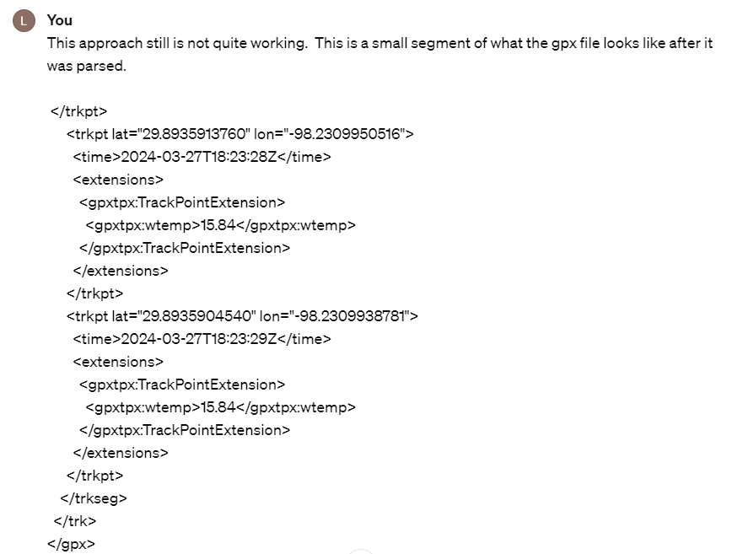
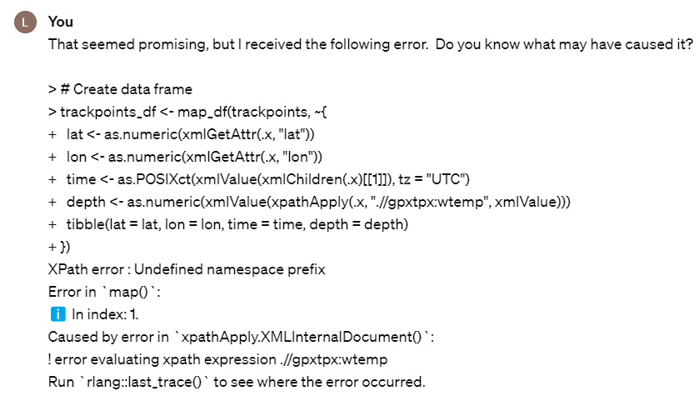
Giving Good Feedback

Slide 10
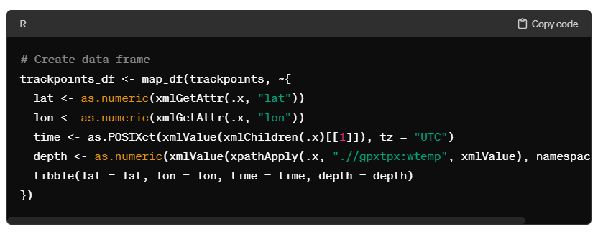
Finally, some (mostly) working code…

Slide 11
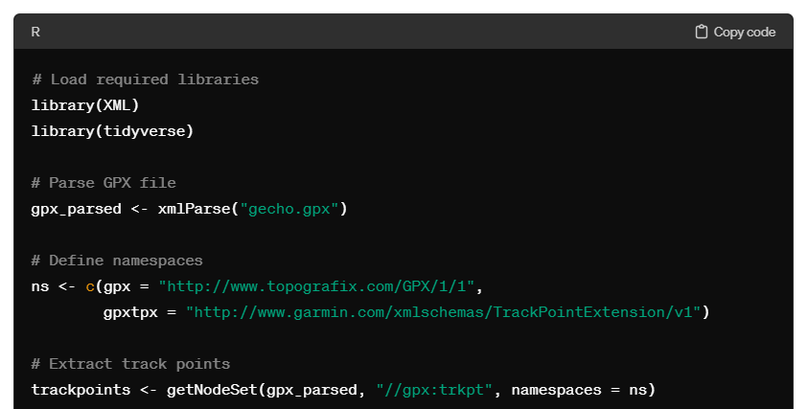
ChatGPT pulling useful information from the web…

Slide 12
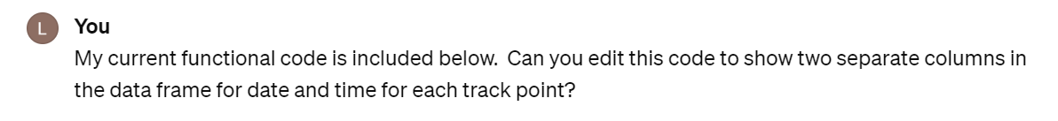
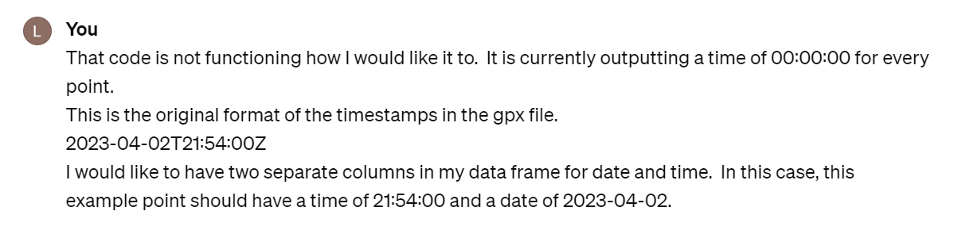
Cleaning Up Dates and Times
Make sure you frequently show ChatGPT what code is working.

Slide 13
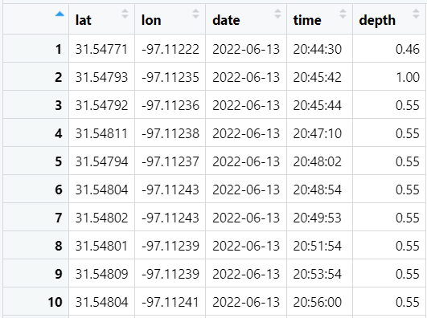
From .GPX to Data Frame…

Slide 14
Behind the Scenes
Added some relevant columns
  Filtered latitude/longitude to only show Lake Waco points
  Added column of ID numbers for unique dates
  Merged with historical lake water level data
  Standardized depth measurement by water level

Slide 15
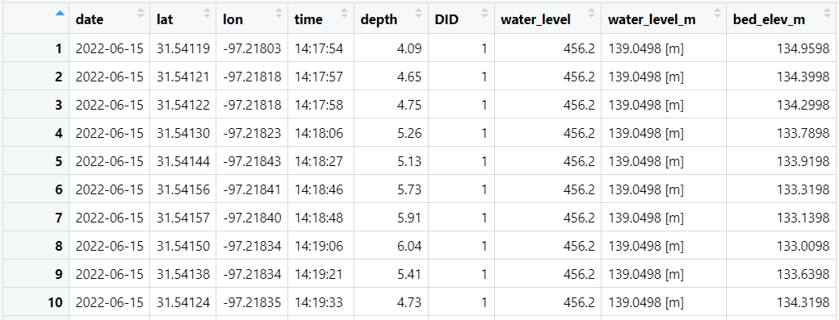
More Columns!

Slide 16
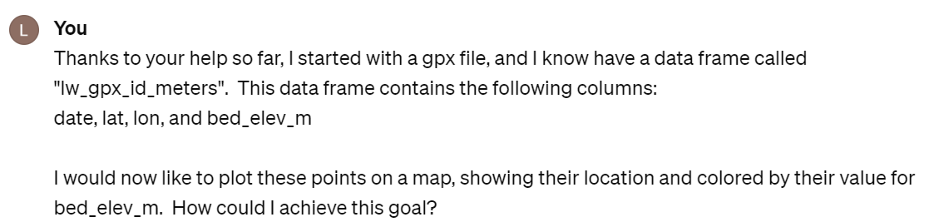
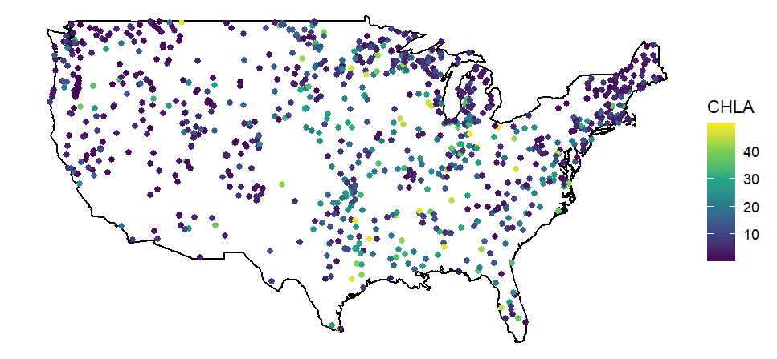
How can we visualize this data?
…ggplot2

Slide 17
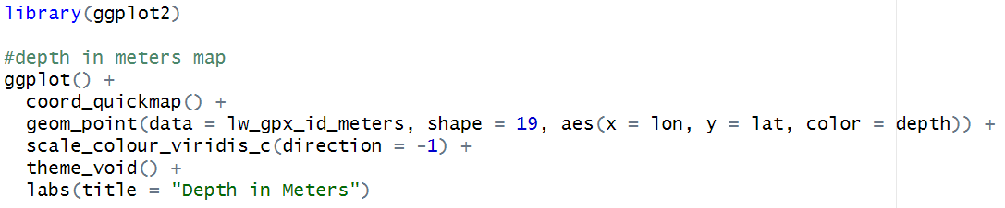
The Moment of Truth…

Slide 18
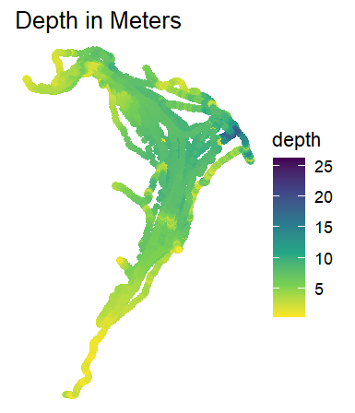
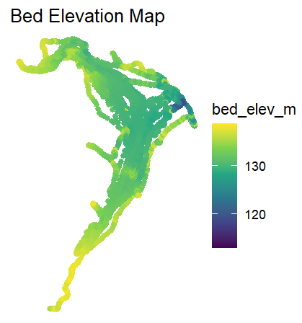
The Moment of Truth…

Slide 21
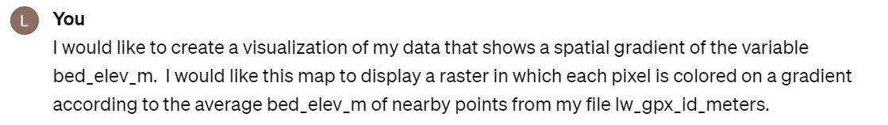
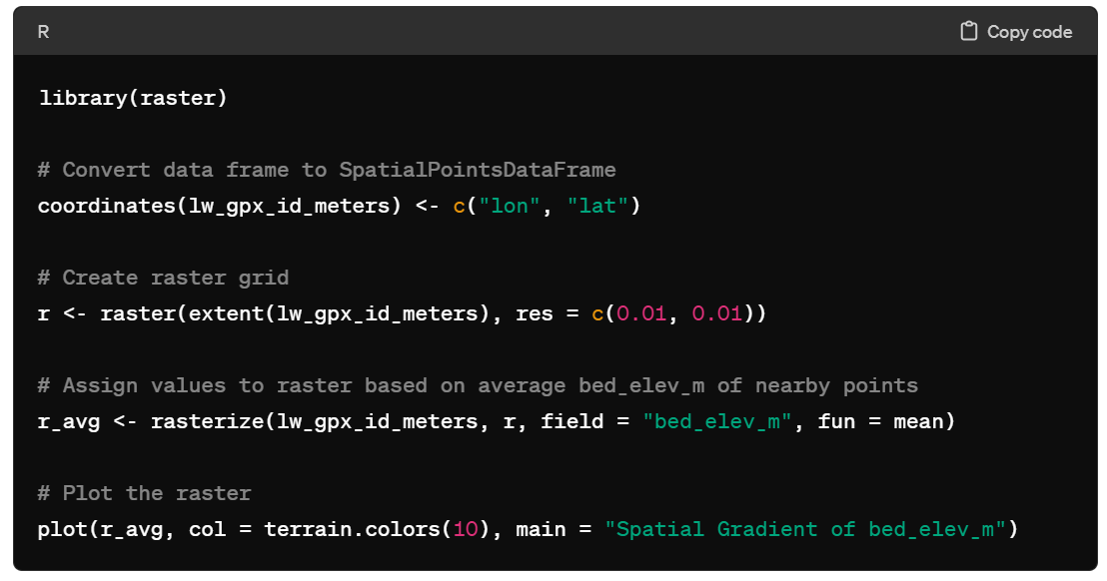
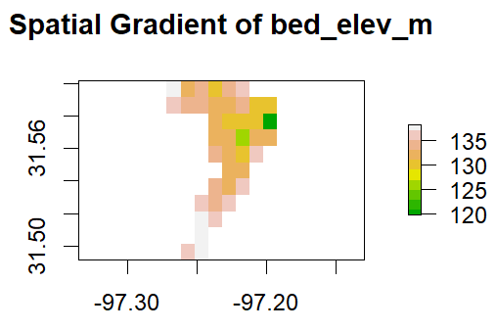
What About Rasters?

Slide 22
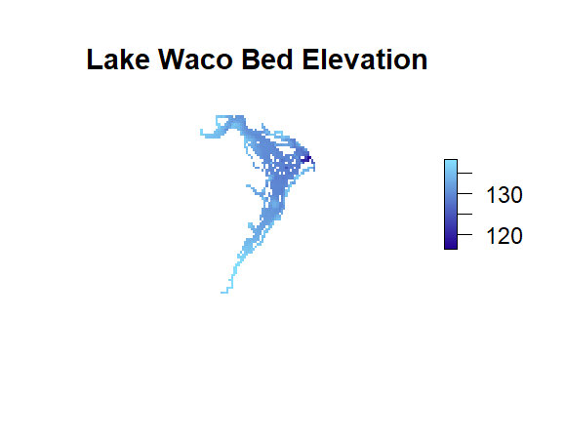
After requesting some basic edits…

Slide 23

Questions?

